Slide 1
PREDICTING DELAYS ON ARRIVAL IN DOMESTIC FLIGHTS IN U.S.A
USING THE LOGISTIC REGRESSION (BINARY CLASSIFICATION) MACHINE LEARNING APPROACH

Slide 2
THE PROBLEM
Issues of delayed and or cancelled flights schedules has been a major problem in the aviation industry for long. Not only do air passengers have to bear with the disappointment of missing out on their favourite destination but also brings revenue loss to the airline companies and creates inconvenience at the said airports due to the strict scheduling of flights. The essence of this machine learning project is to train a machine to predict with high level of accuracy whether flight to a destination will be delayed or not given certain features using the logistic regression algorithm.
The top 13 airlines companies, the top 20 destinations and Origin airport were used for the purpose of this project

Slide 3
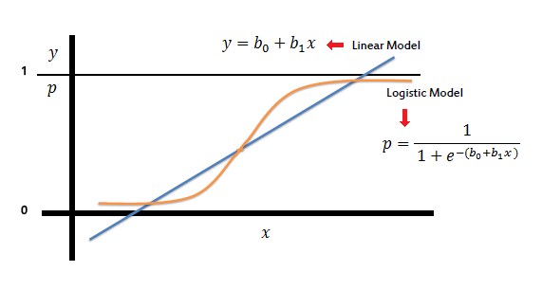
PROPOSED SOLUTION: LOGISTIC REGESSION

Slide 4
DATA SOURCE & DESCRIPTION
The airline dataset was retrieved from the United States Department of Transportation (Bureau of Transportation Statistics) and used solely for the purpose of this project. The data repository has information on all local flights within the USA for the months of June, July and August 2014. Data Preprocessing
The weather data was also retrieved from the National Centers For Environmental Information (NOAA) . Contained information about temperature, humidity, atmospheric pressure amongst other metrics from weather stations within the USA

Slide 5
PREPROCESSING
Replace Weather Station Names with IATA codes
Deleted rows that had vital data absent
Calculating weather averages by weather station and hour
Splitting time columns in both airlines data and weather data
Extracting top 20 airports by traffic from airport data
Extract flight info relating to only top 20 airlines from the airlines data
Converting strings into float using function
Creating dummy variable
Scaling dataset

Slide 6
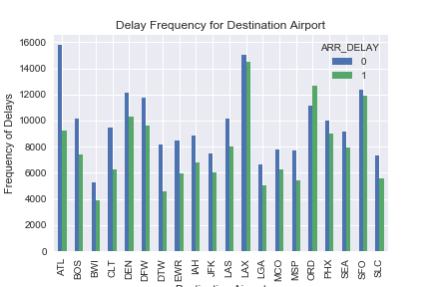
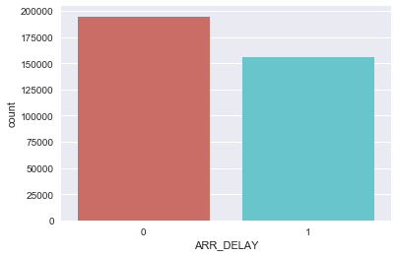
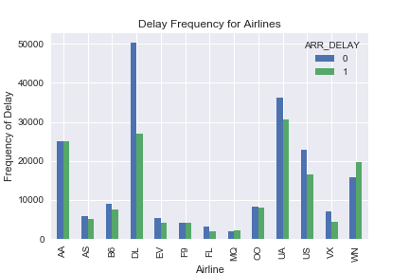
Visual Representation from Dataset

Slide 7
MODELLING
Split the data in predictors and response
Split the data up into training set, test and validation set
Fitted 2 Logistic Regression with Cross Validation to the training data using the l1 penalty
Fitted 2 Model using the Lasso with Cross validation with different values of alpha
I used the tools from scikit-learn for building my models

Slide 8
MODEL PERFORMANCE MEASURES
The best model was the l_classifier which had a prediction rate of 62 %
Precision, Recall, F-measure and Support for l_classifier model
 | Precision | Recall | F1 score | support
0 | 0.63 | 0.76 | 0.69 | 39092
1 | 0.60 | 0.45 | 0.51 | 31077
Total/Avg | 0.62 | 0.62 | 0.61 | 70169

Slide 9
Conclusion and References
The predictive model was able to predict with an accuracy score of 81%
GITHUB Link for code:
https://github.com/hermannamoako/MLLRFlights/blob/master/MLLRFinalCode.py
REFERENCES:
https://www.datasciencecentral.com/profiles/blogs/predicting-flights-delay-using-supervised-learning
http://cs229.stanford.edu/proj2012/BandyopadhyayGuerrero-PredictingFlightDelays.pdf

